Slide 1
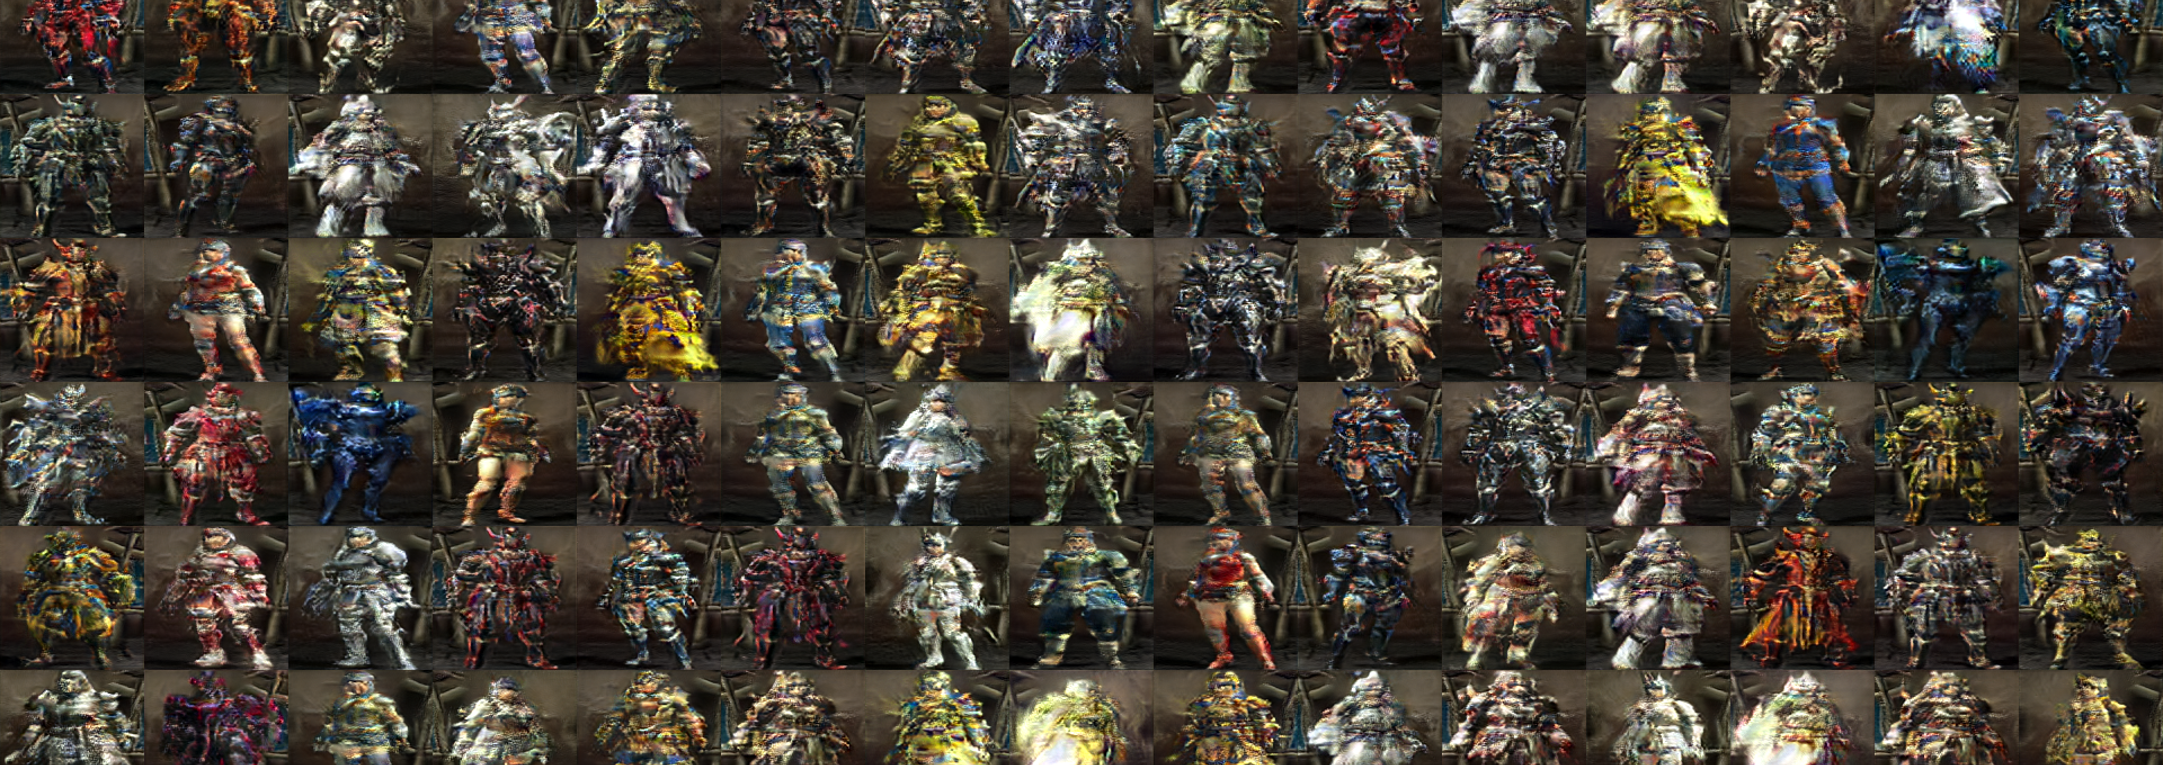
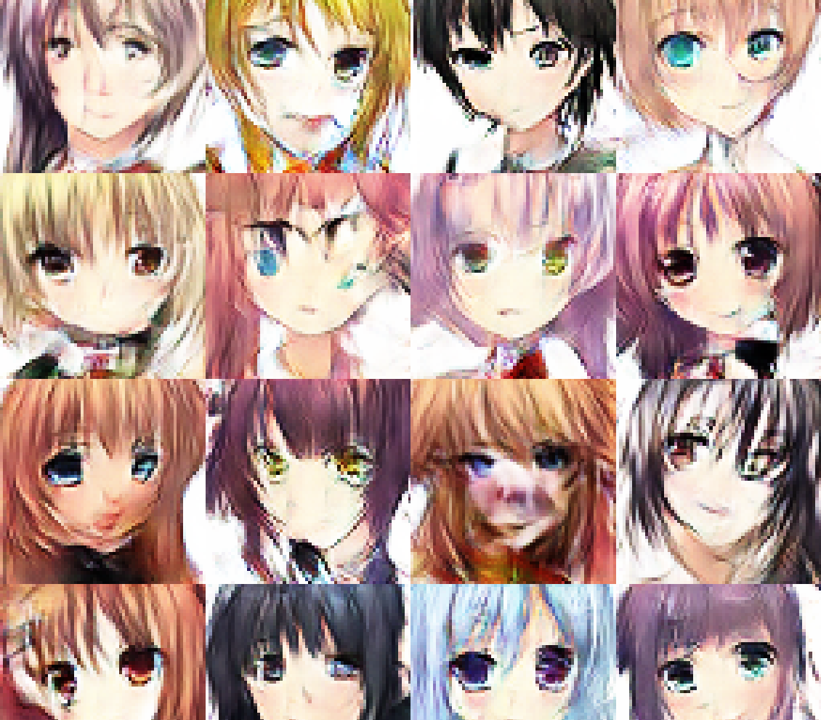
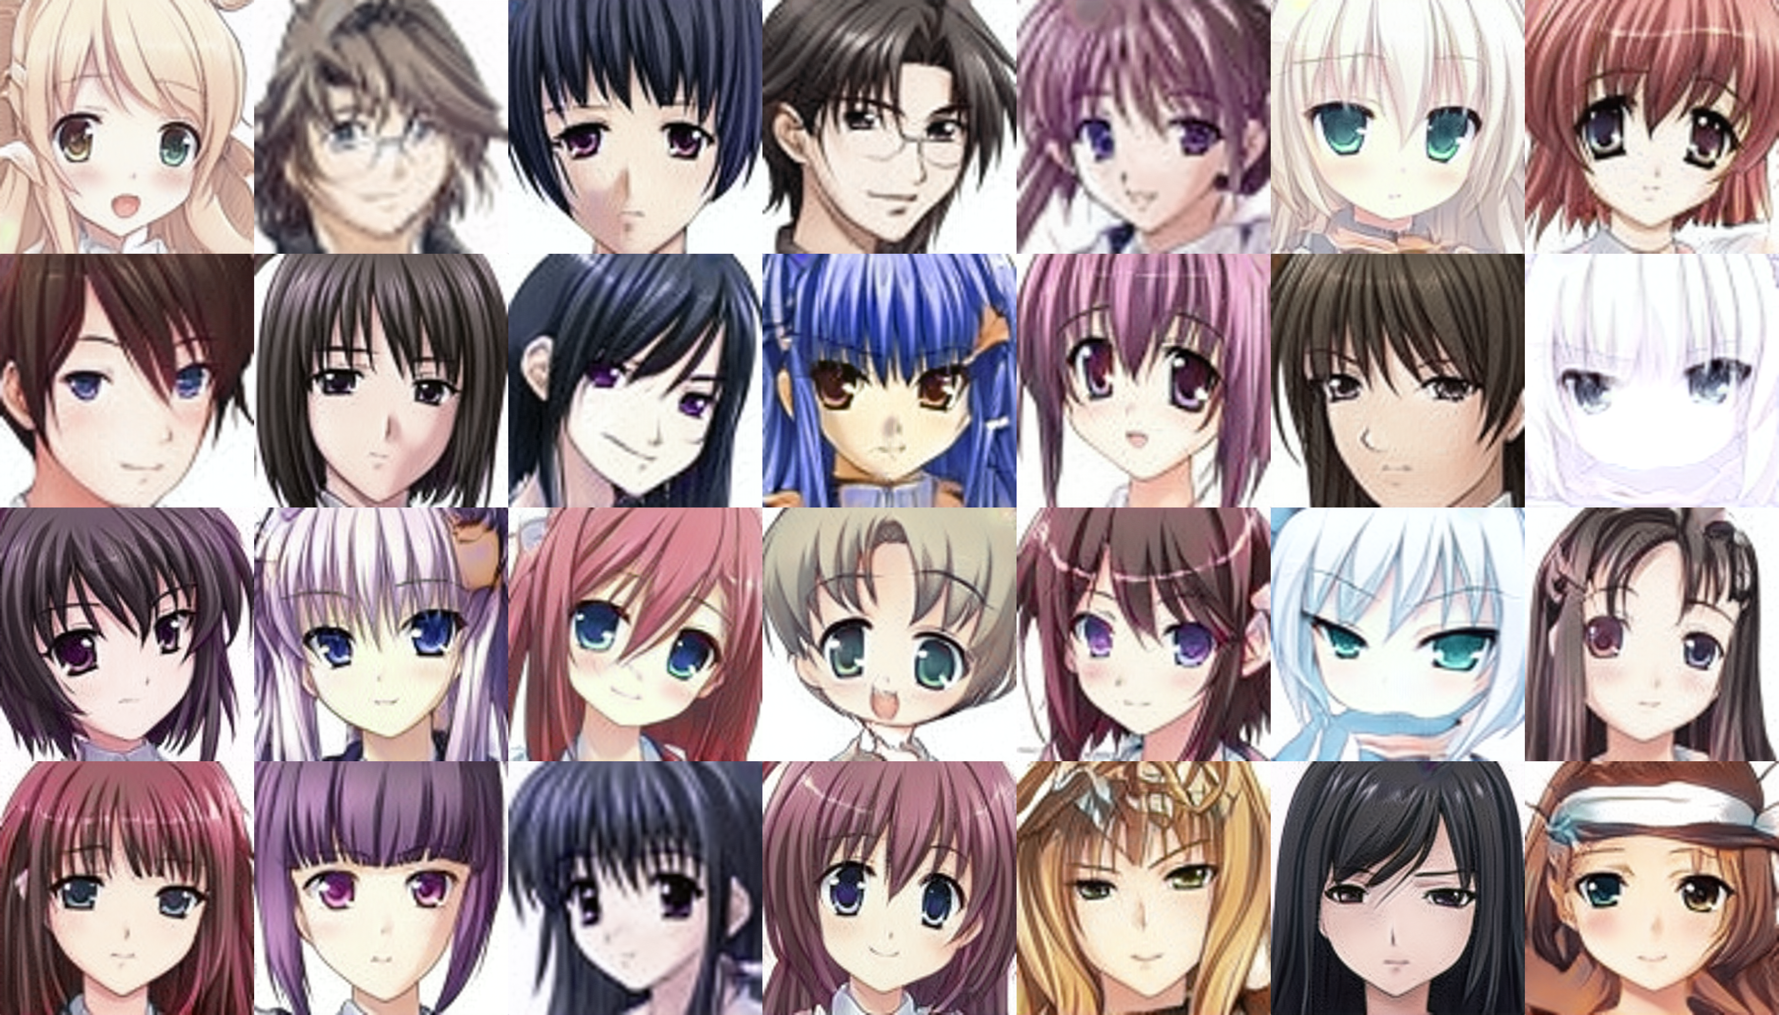
Generating images
For Concept Design using
Generative Adversarial Networks
Justin Huang
https://jvhuang1786.github.io
https://www.linkedin.com/in/justinvhuang

Slide 2
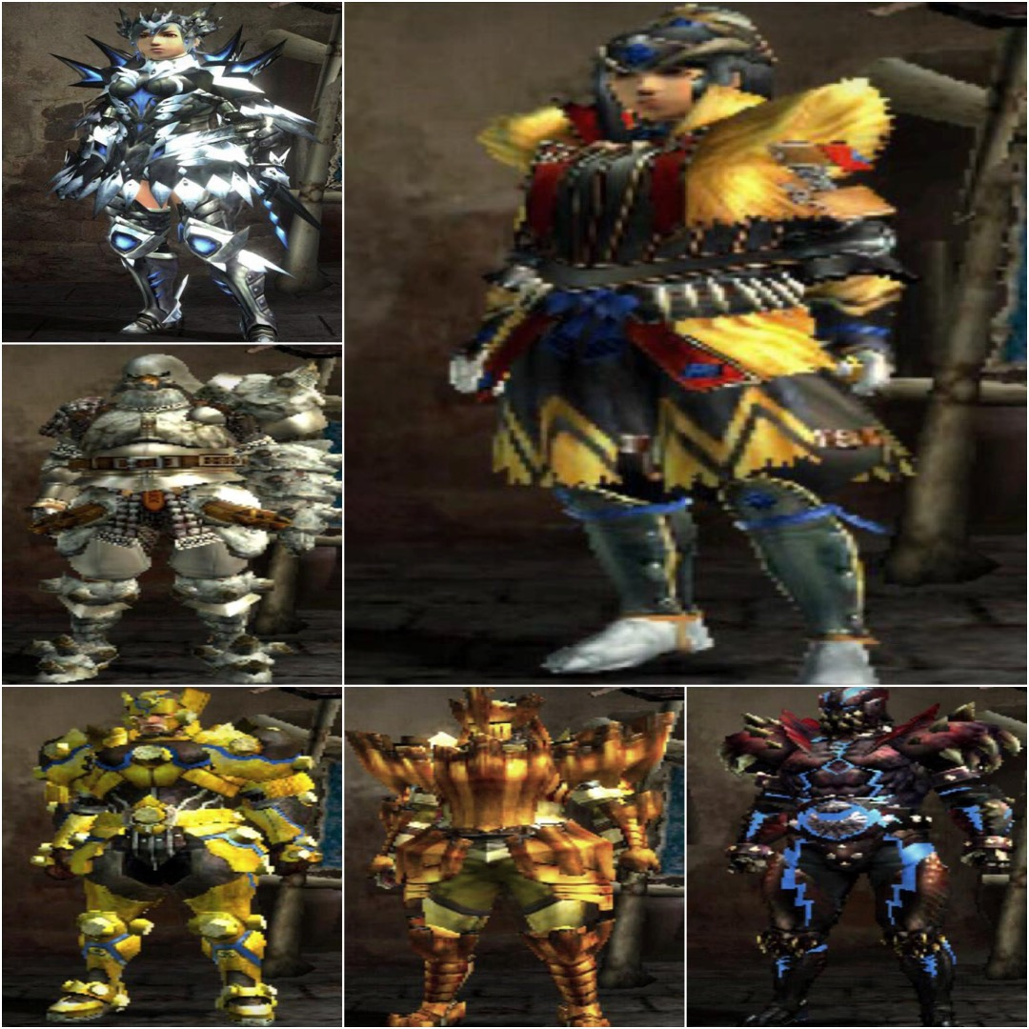
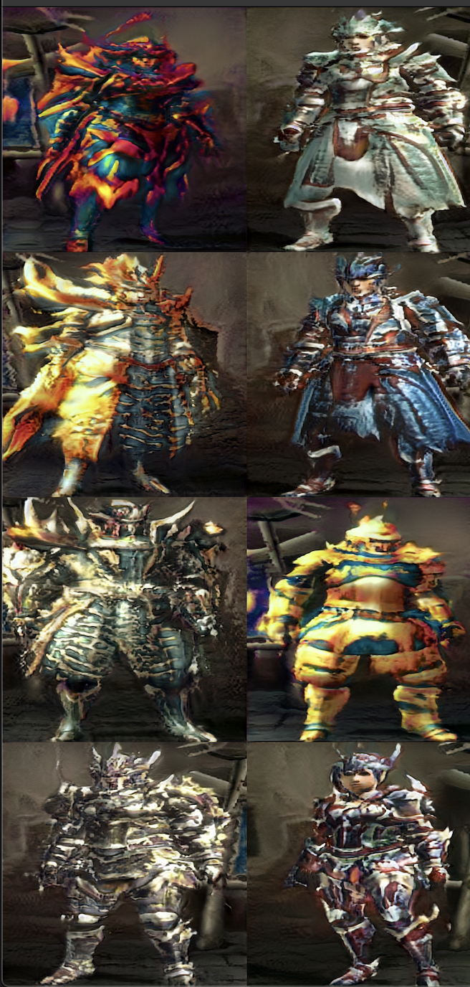

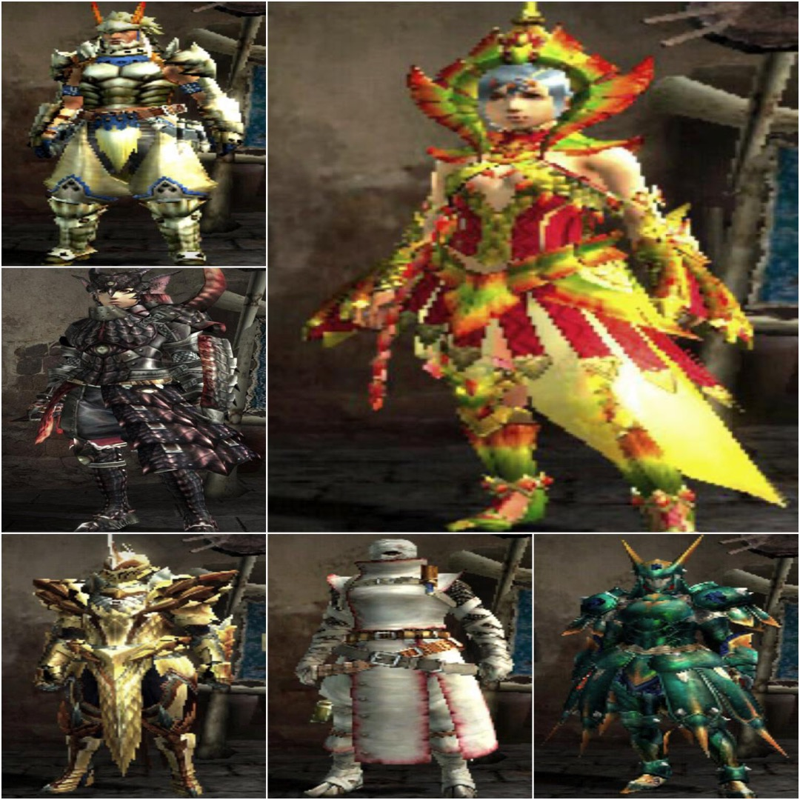
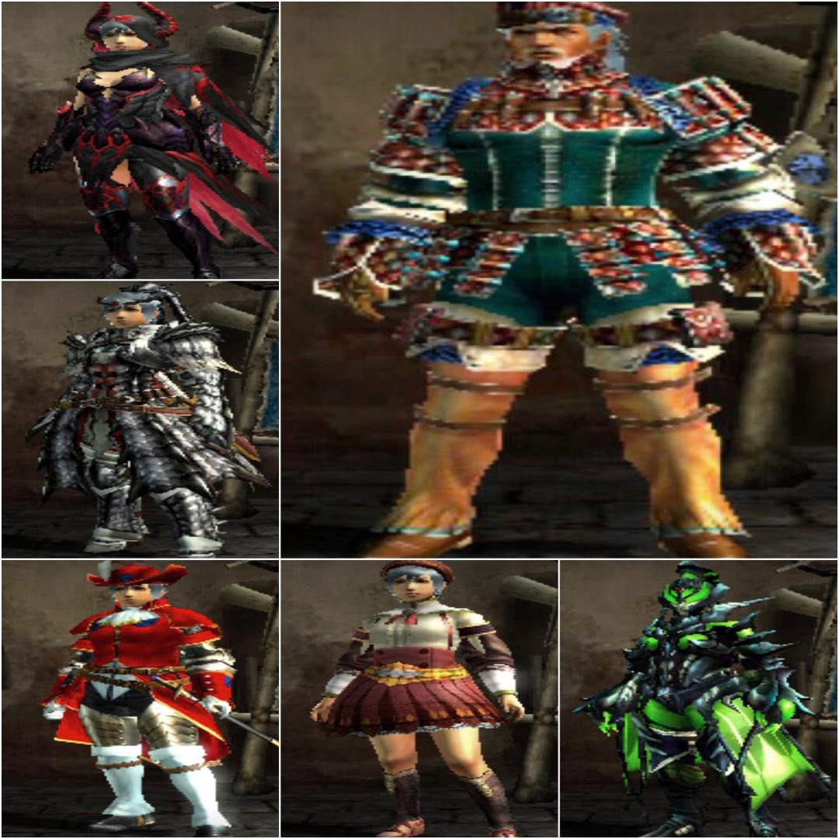
Input of Old Assets created by studio
Generate new Images for Concept design
Problem Statement
Image Generator and model
Learning to draw beboo bebop 0101010

Slide 3
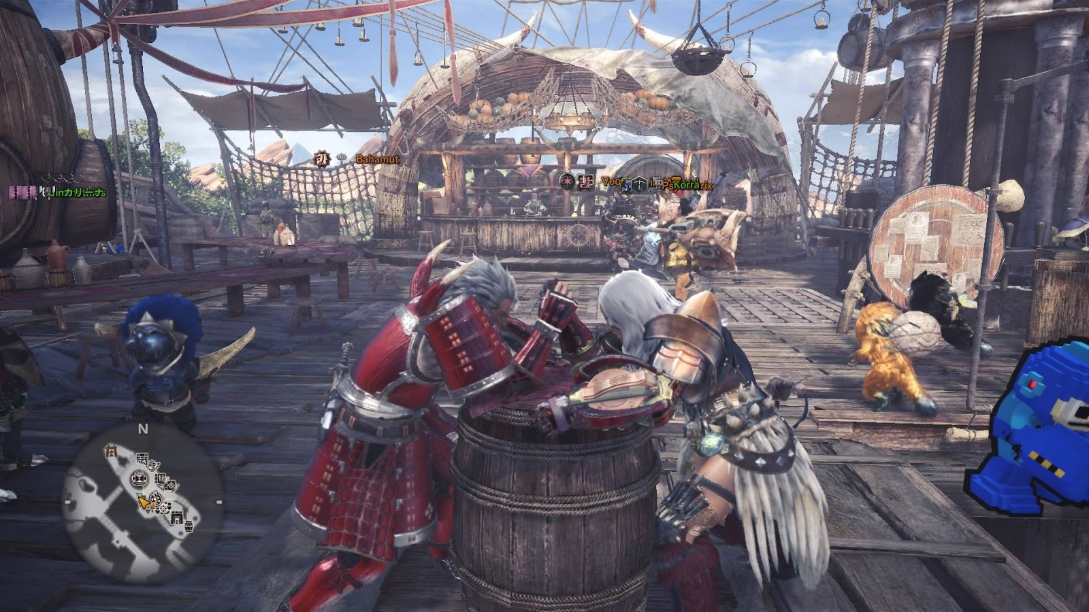



Generative Adversarial Networks Intro
+Attack
+Stamina
+Attack
+Defense
Generator
Discriminator
The Idea is to have two neural networks battle each other improving weights
The neural network learns in the process as both Generator and Discriminator get better
Gets to the point where the Fake images generated by Discriminator are very close to the real images

Slide 4
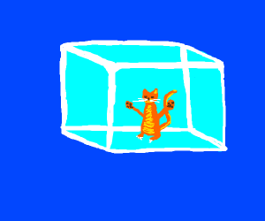
Vanilla Generative Adversarial Network Basic Structure
Generator Backpropagation
Random
Input/ noise array
Generator
Creates
fake images
Sample
Generator
Loss
Discriminator
Classify Fake or real
Real Images
From dataset
Discriminator Loss
Sample
Discriminator Backpropagation

Slide 5
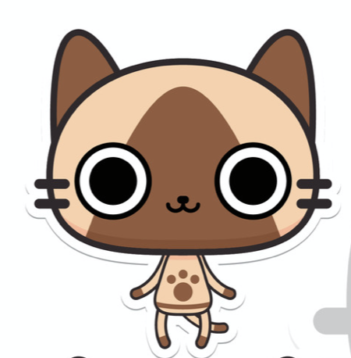
Gradient Descent and Backpropagation Basics
Cost
The goal is to descend the gradient to reach the bottom where the cost function is the lowest.
However, our cat here is blind. It can only slowly traverse downwards to see if the cost decreases. It would take repeat this step of taking steps forwards until it finds the lowest-possible point.
Step size is dependent on the learning rate which is a hyperparameter to the model. Too small and it takes forever, too big and we might overshoot the minimum.
I’m blind
I start out at a random point
Trap local min incoming will our cat realize this? Yes with SGD and batch size!
Global minimum
Parameter
This would be either the weight or bias normally but could be billions of parameters.
This would have a billion-dimensional space compared to our 1-dimensional space here.

Slide 6
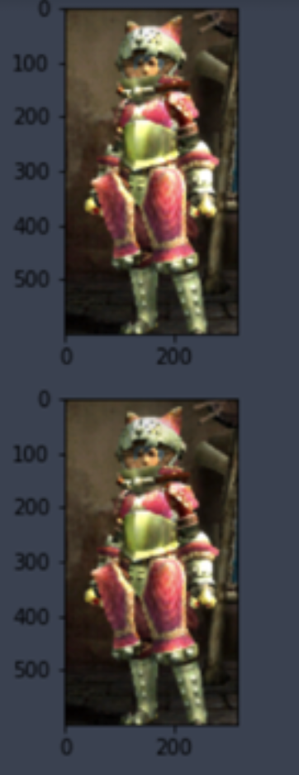
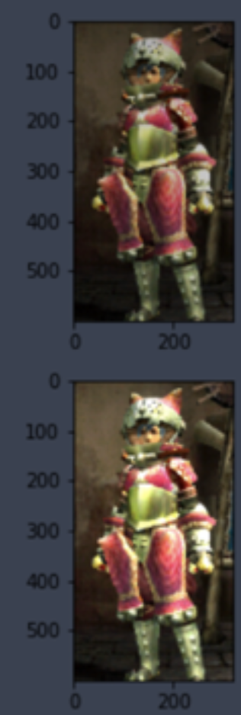
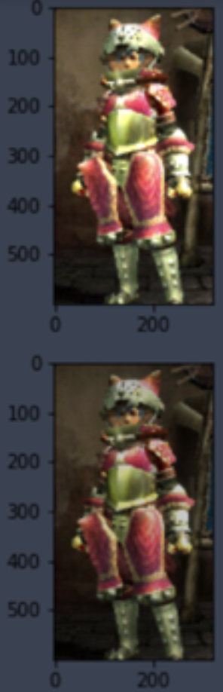
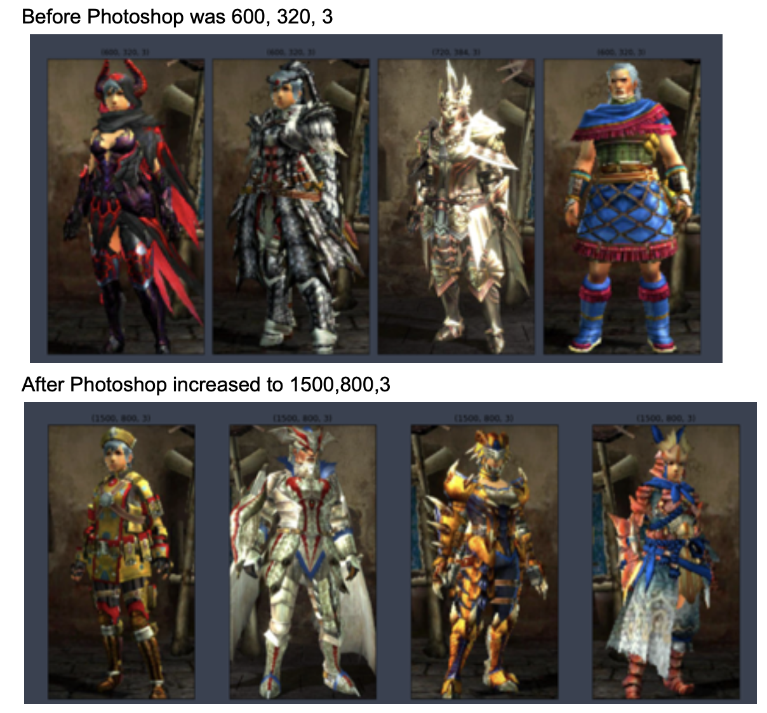
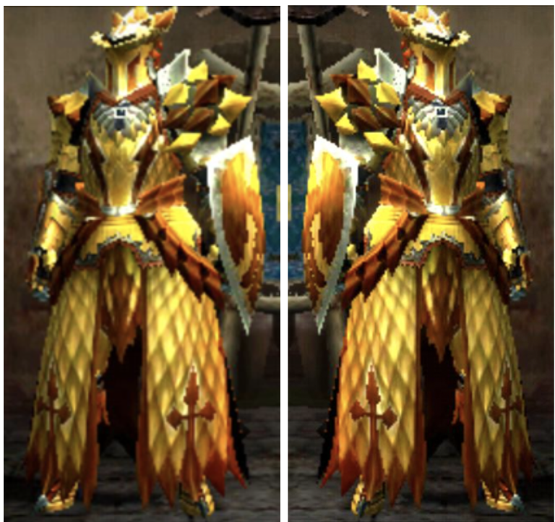
Data Augmentation increase dataset from 1083 to 19437
Mirror our Images
Brightness random sampling 0.7 to 1.2
Resolution increase with PS

Slide 7
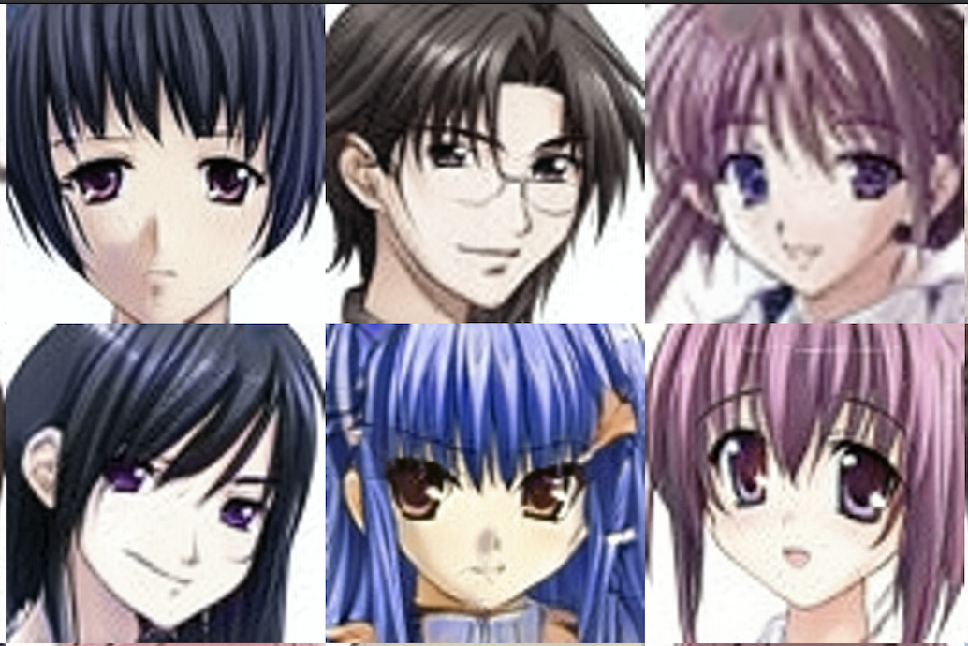
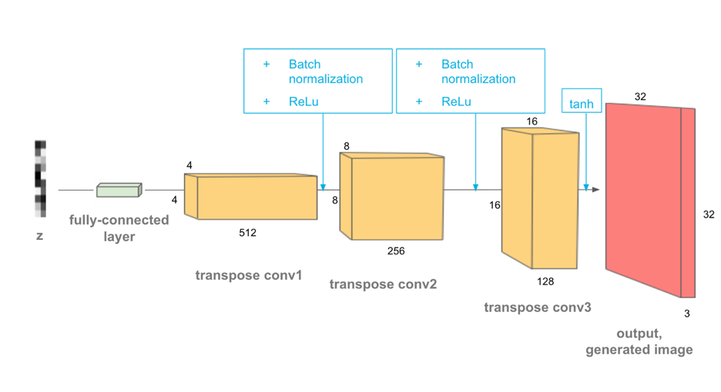
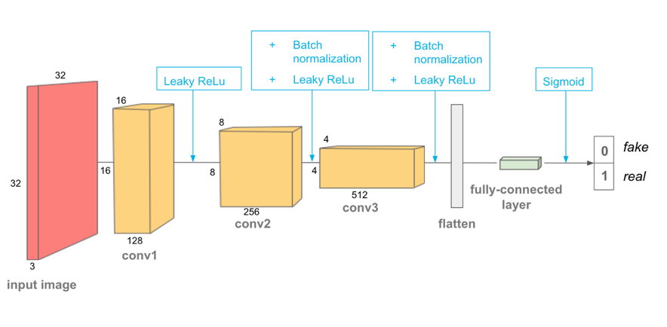



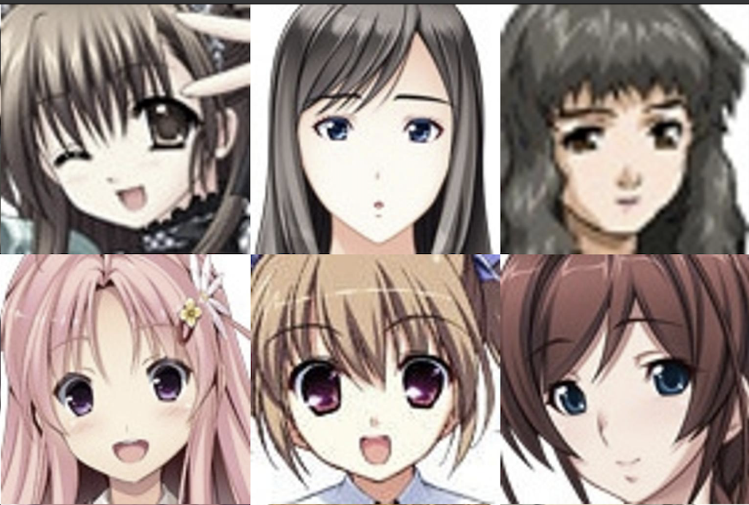
Deep Convolutional GAN Structure Quick Visualization
Feed in Fake
Discriminator
Generator
Fake
Feed in Real
Real

Slide 8
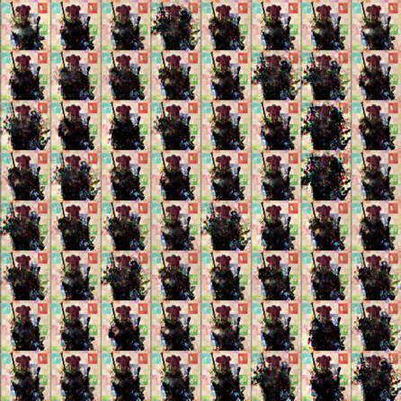
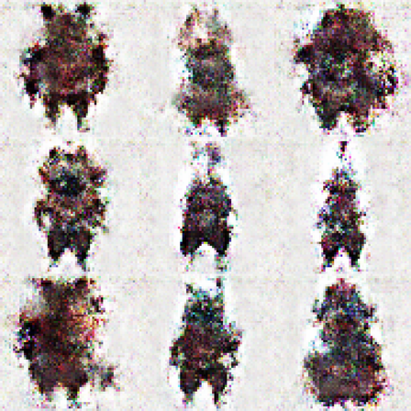
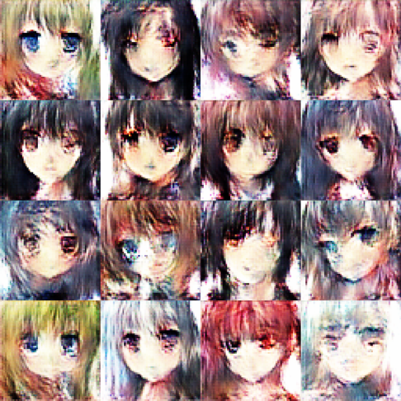
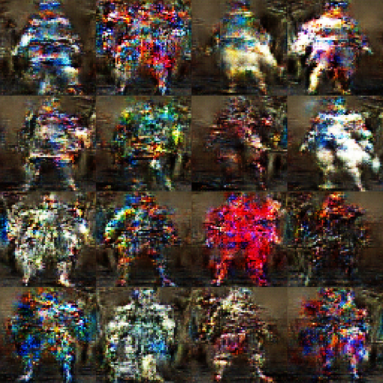
2000 Steps visualization
2000 steps only took 5 hours to be able to visualize some images already
Style Gan will take a few days to train
Is an improvement than vanilla GAN.
Batch normalization separates the fake images and real images instead of putting them together
Uses Leaky ReLU so we don’t have any dead neurons

Slide 9
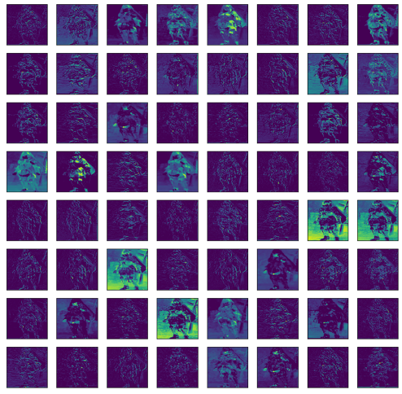
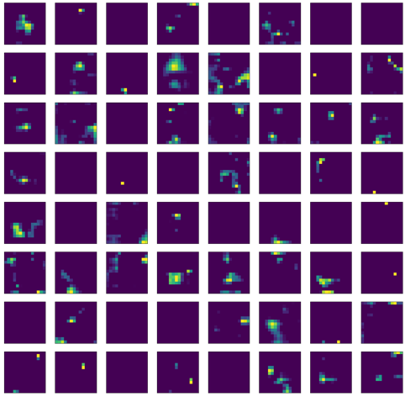
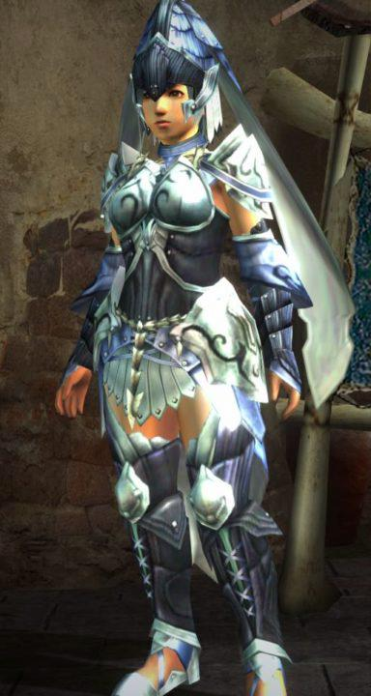
VGG Model Visualize Feature Map CNN
Activation map/Feature map
Capture result of applying filter to input image or another feature map.
The goal is to understand what features detected or kept
Closer to input have more detail while further is going to have more general features.
Closest to input
Furthest from input

Slide 10
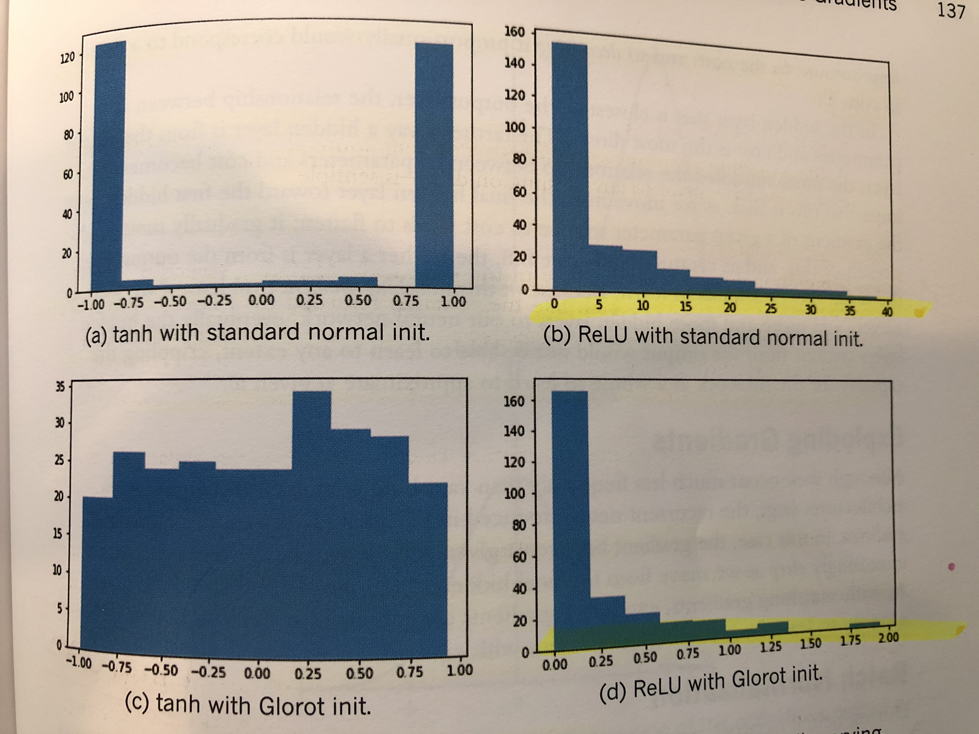
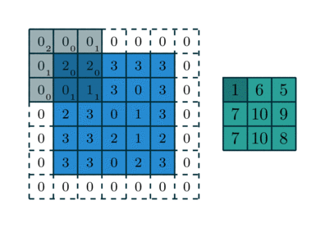
Hyper Parameters
Filters | Was Conv2D for discriminator down sample from 64 to 512, Generator up sample using Conv2dTranspose
Kernel Size | Was set to 4
Strides | Size of the step the kernel takes was set to 2
Padding | Allows no loss of information to include padding of 0 set to padding = ‘same’
Kernel initializer | Set to glorot uniform to avoid neurons getting saturated or having too strong opinion before training
Here’s a model from deeplearning.net
Has 3x3 kernel size
2x2 Stride
5x5 input pad
With 1x1 padding
Normal Initialization vs Glorot Intialization

Slide 11
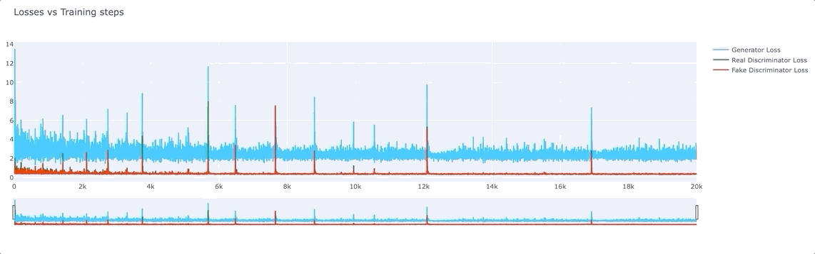

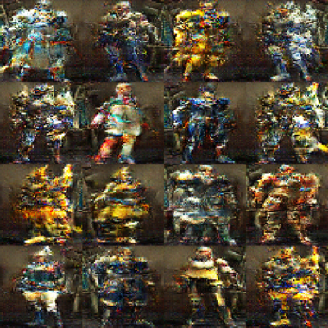
Results after 20000 Steps

Slide 12
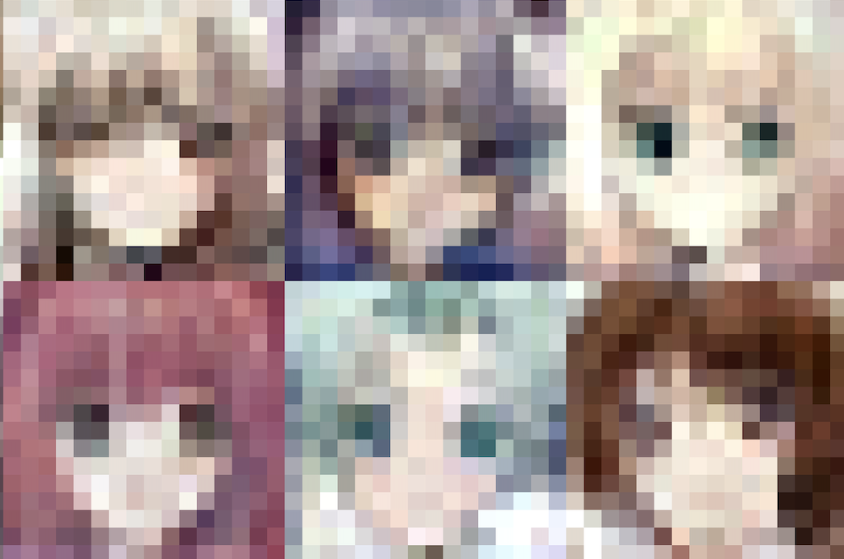
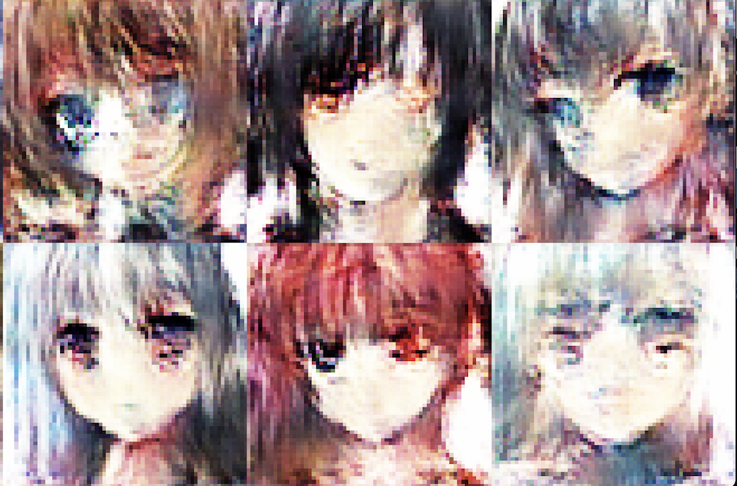
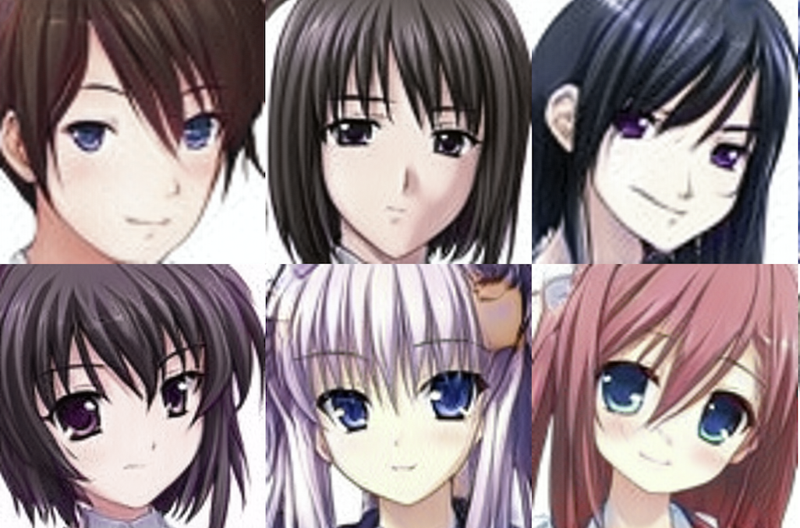
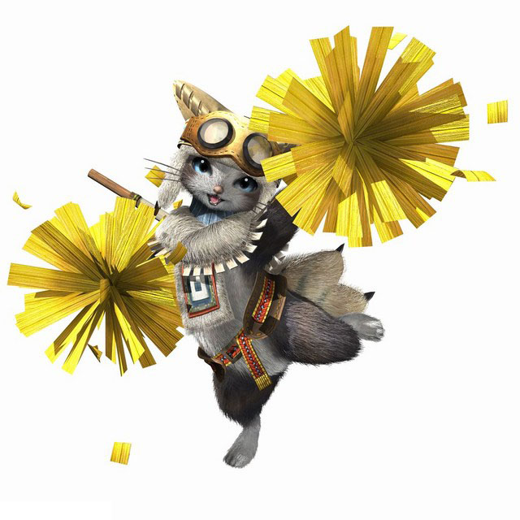
GAN Measure
Usually the most common way we can tell our GAN is doing well is just looking at the comparison of the fake images generated by generator
Getting better!
Getting better!

Slide 13
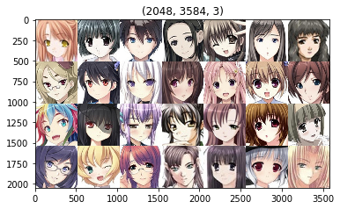
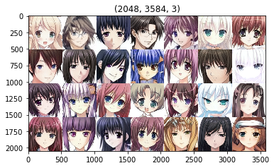
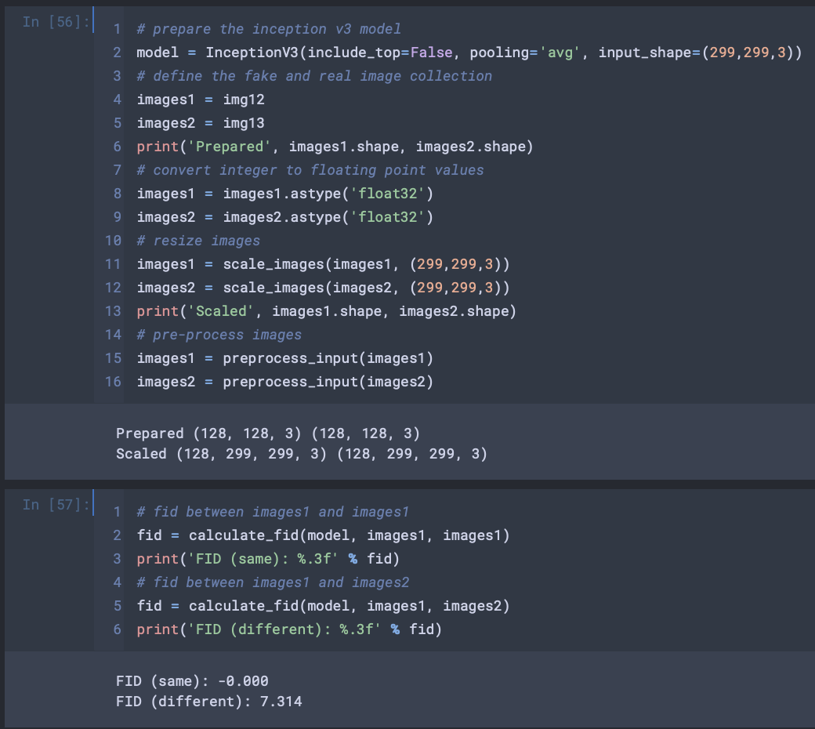
Quantitative Inception Score & Frechet Inception Distance
IS uses two criteria in measuring the performance of GAN
Quality of generated Images
Diversity
Higher the score the better indicating we can tell what the image is and is separated into the right number of classes with conditional probability
FID uses the same network as IS but:
Model data distribution using Gaussian distribution
use mean and covariance
Finds the score between the real images and generated images.
Lower the score the better the image quality and better diversity

Slide 14


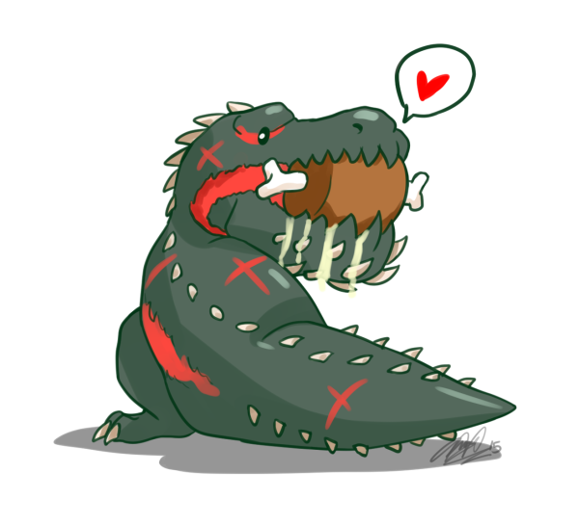
Quantitative Perceptual Path Length
The idea here is to choose the “perceptually” shortest distance.
For example, using a latent variable z1 produces a brownish light colored palico cat and a latent variable z2 produces a black palico cat.
Since only color is being changed the ideal path is the blue line where the middle ground is a gray palico cat which is “perceptually” the shortest distance.
The longest distance “perceptually” is the dinosaur as it needs to change shape and color
The lower the PPL the better.
Light Color Cat
Targeted Gray color Cat
z1
Black Cat
z2
Angry Dinosaur

Slide 15
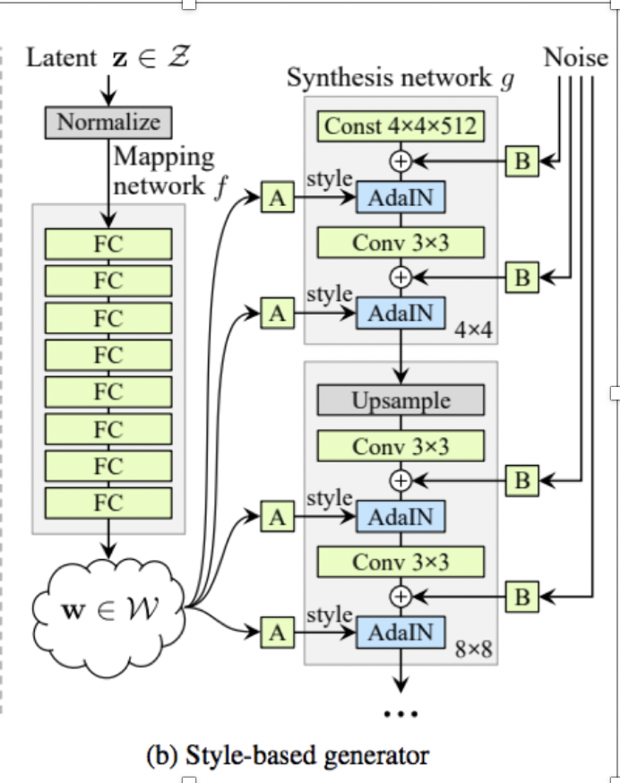
Style Gan Improvement
Use Progressive Growing to gradually increase the resolution.
Synthesis network g
Generate images from fixed value tensor, not generating images from stochastically generated latent variables as in conventional GANs.
StyleGAN generates image from fixed 4x4x512 tensor.
And stochastic latent variables are used as style vectors in StyleGAN.
The stochastically generated latent variables are used as style vectors through Adaptive instance normalization at each resolution after nonlinearly transformed by an 8-layer neural network.

Slide 16
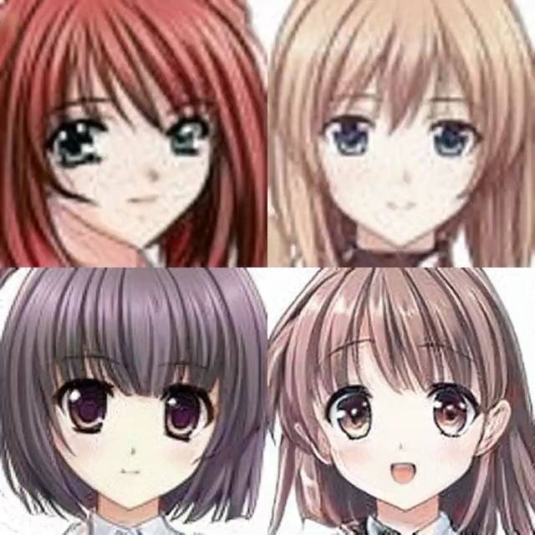
Style GAN- Anime Faces
Anime Faces
Started with 85000 images
512 x 512 dimension using tfrecords
LR was 0.003
Minibatch repeat was set to 5
Trained for 7 days

Slide 17
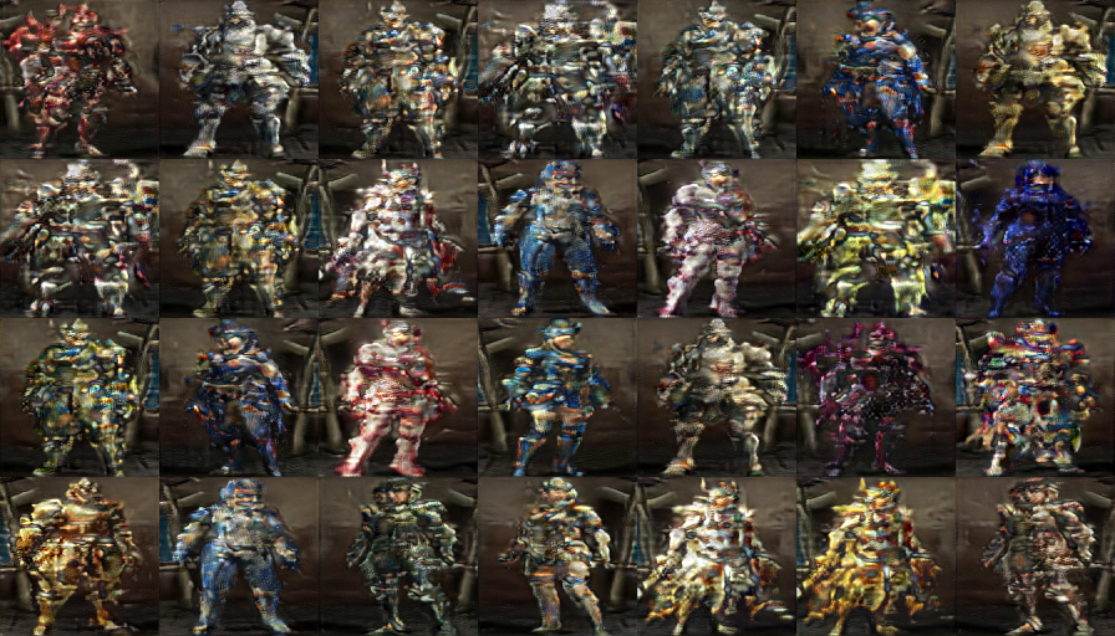
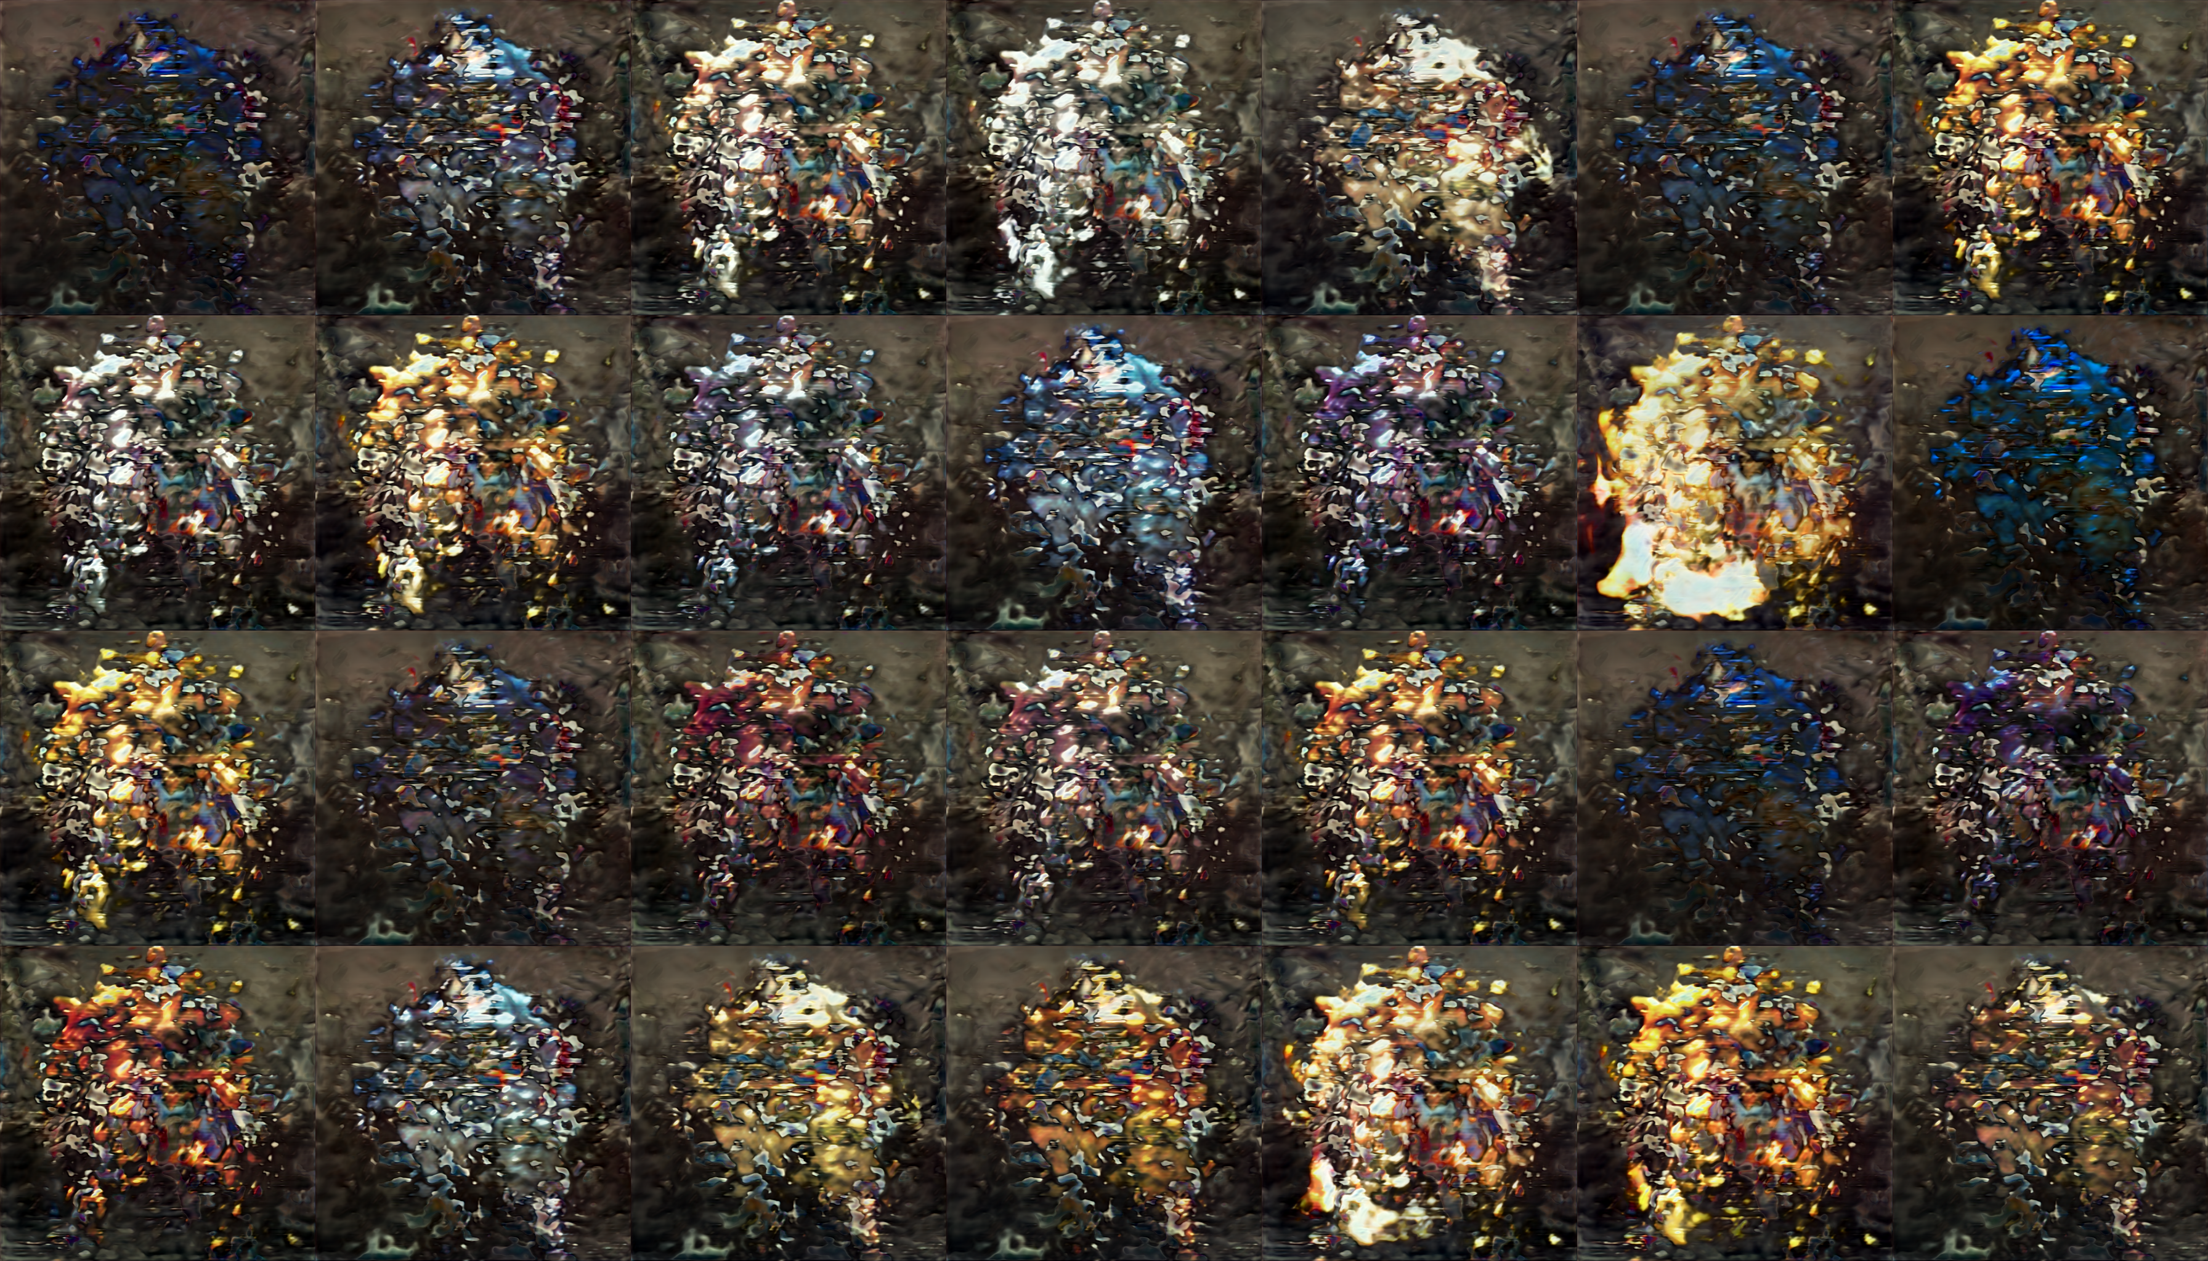
Style GAN- MHXX Armor
Hoping it was as easy here’s 2 days of training
Mode Collapse at 4 days of training
What is mode collapse
Mode collapse when generator only capable of generating one or a small subset of different outcomes, or modes. Like our exploding blurred armor on the right at 4 days of training
Possible reasons for mode collapse
Not enough data vs our face dataset. Only 19437 we might be overfitting the data with augmentation
Generator has collapsed to a single point believing what it is drawing is real, then discriminator learns from that single point ang gradient descent unable to separate identical outputs

Slide 18
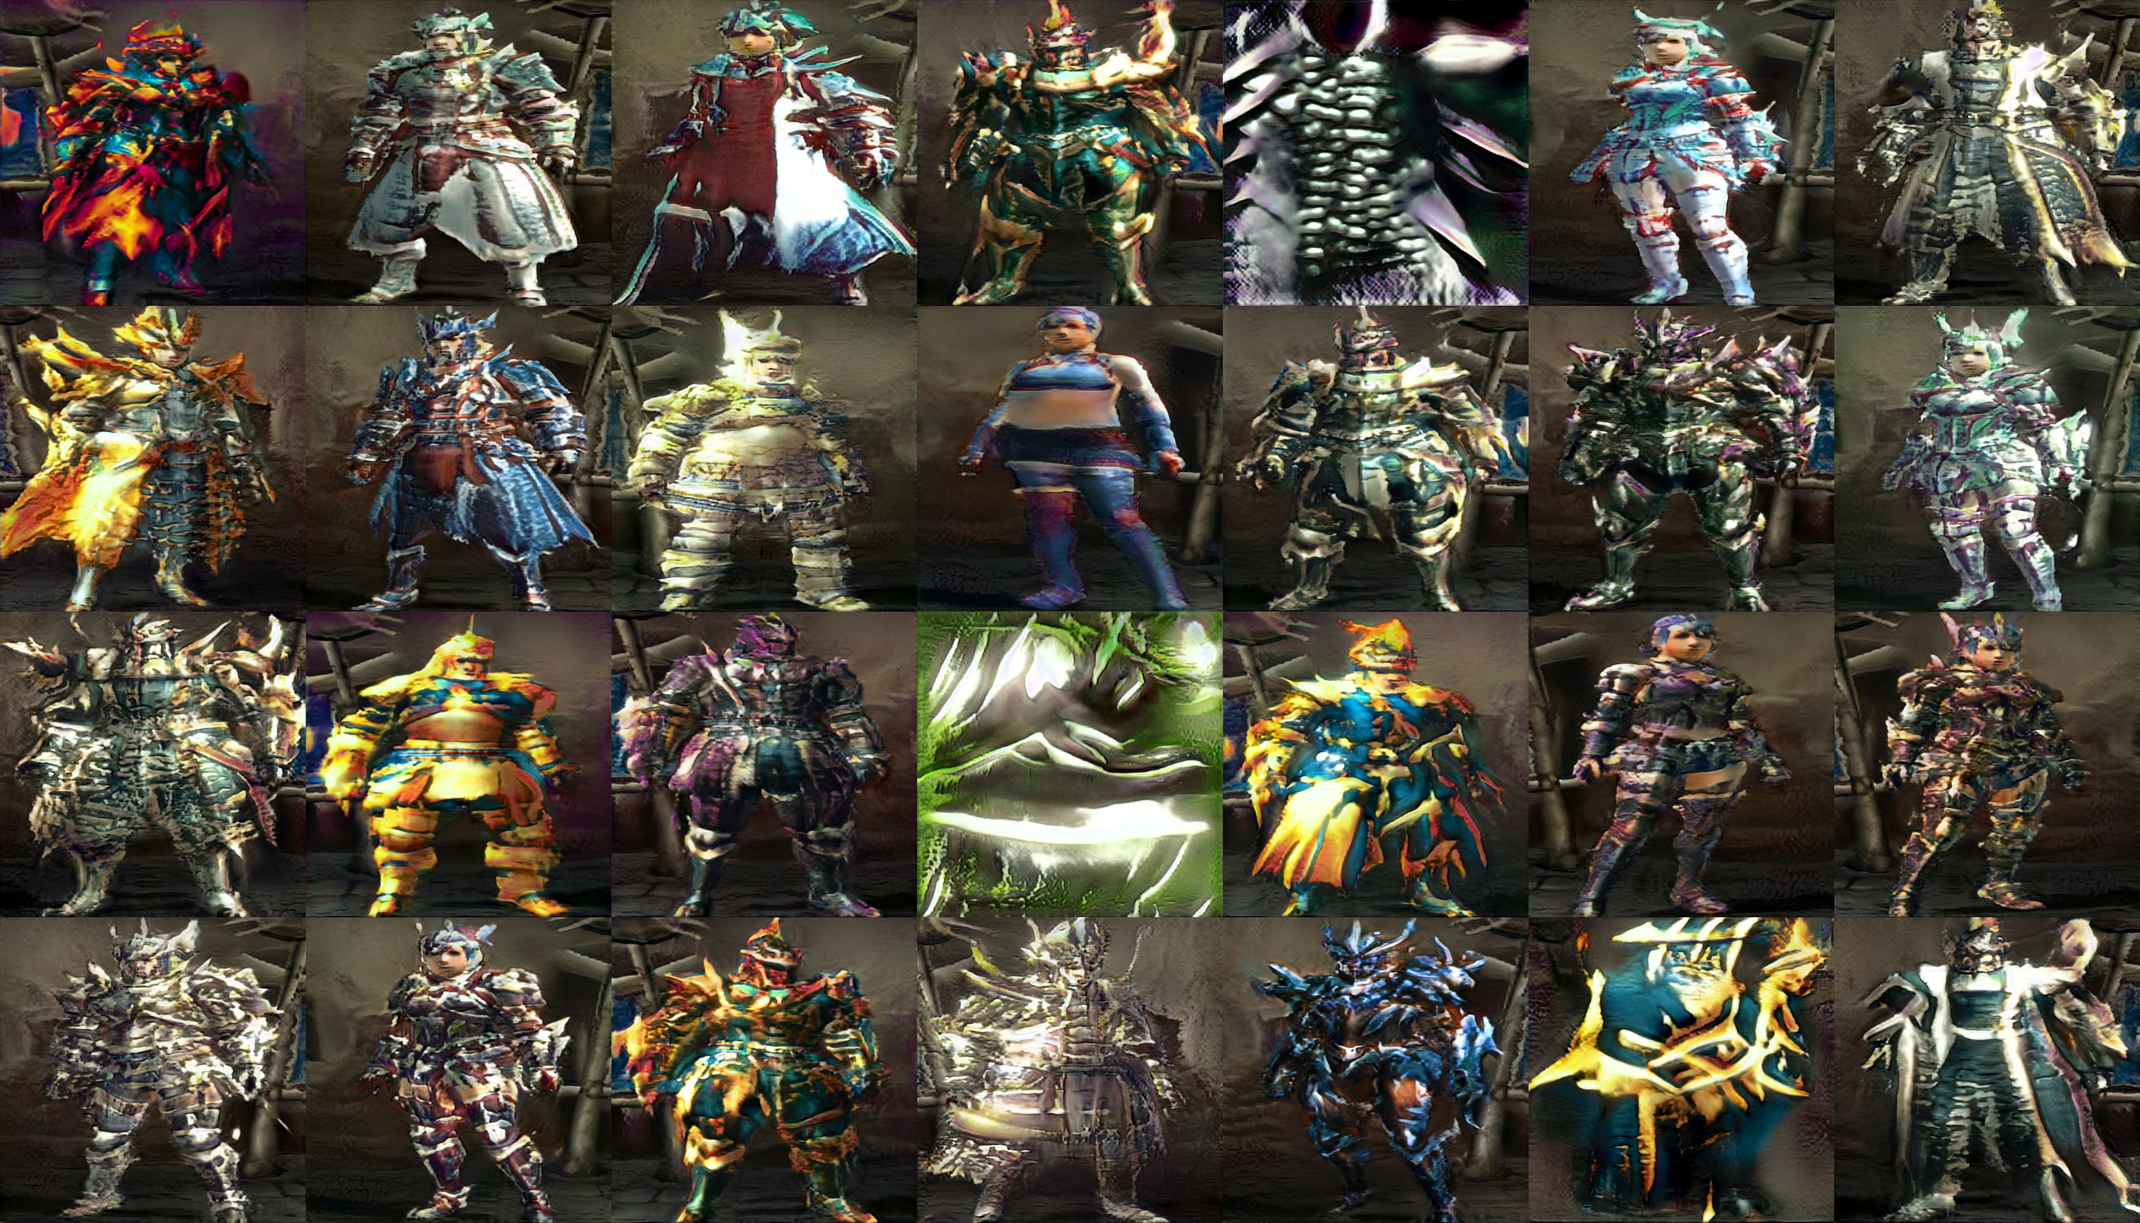
Transfer Learning using anime faces
Hyperparameter changes
Transfer learning Results in 16 hours finally armor and face detail!
While learning rate is one of the more important thing to set in Stylegan 1 for some reason you can only set learning rate the same for D and G in Stylegan 2; decreased LR to 0.001
set minibatch repeat to 1 instead of 5. Perhaps having too many minibatches to give to discriminator caused the model to be unstable
Transfer Learning take a model trained on a large dataset and transfer its knowledge to a smaller dataset.
Set resume_kimg to the pickled face model at 7440
This allows us to use the advantage that the anime face model had a bigger data set

Slide 19
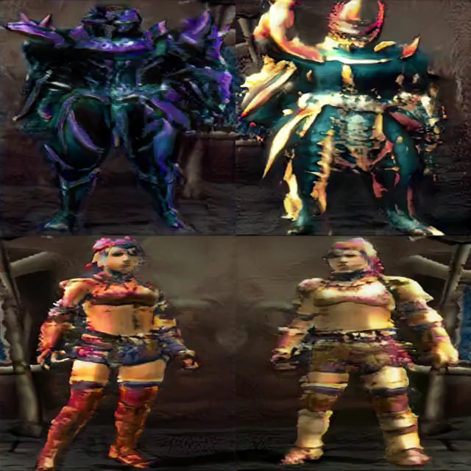
Armor Morphing we can choose a concept Art!

Slide 20
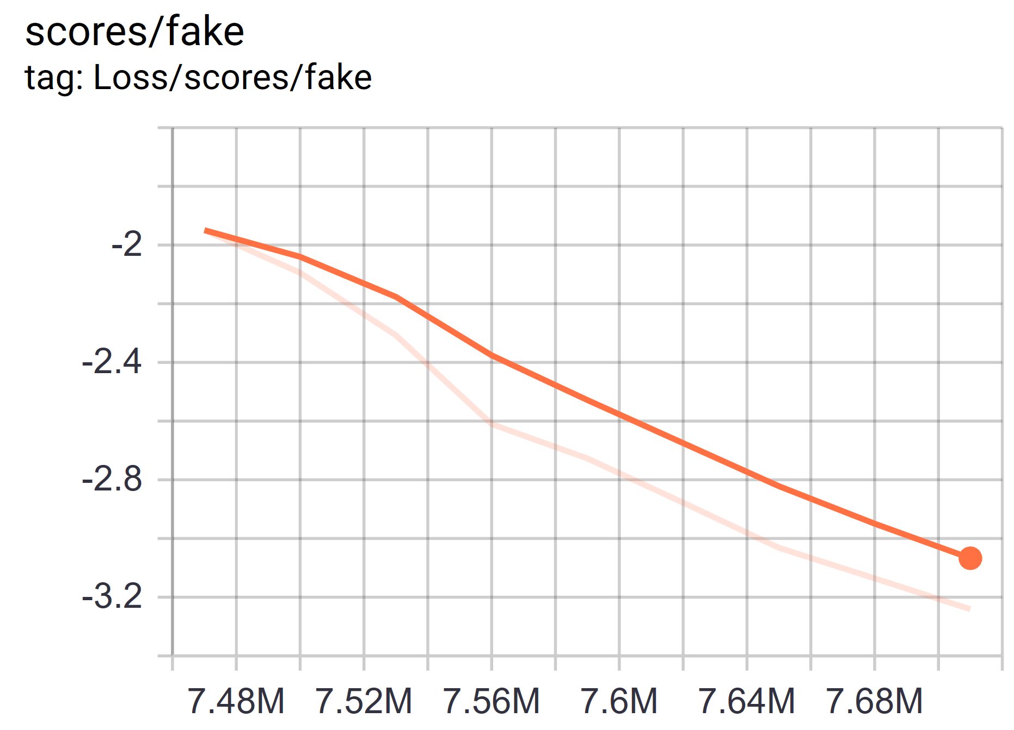
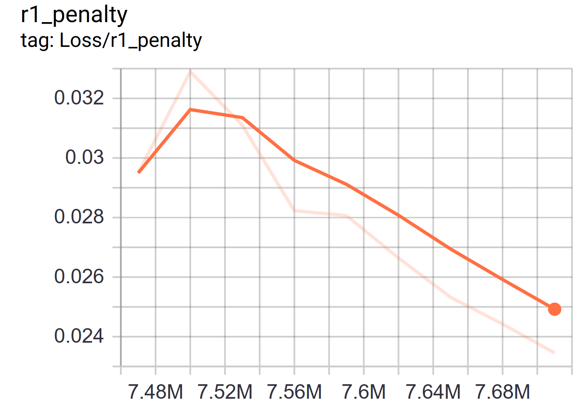
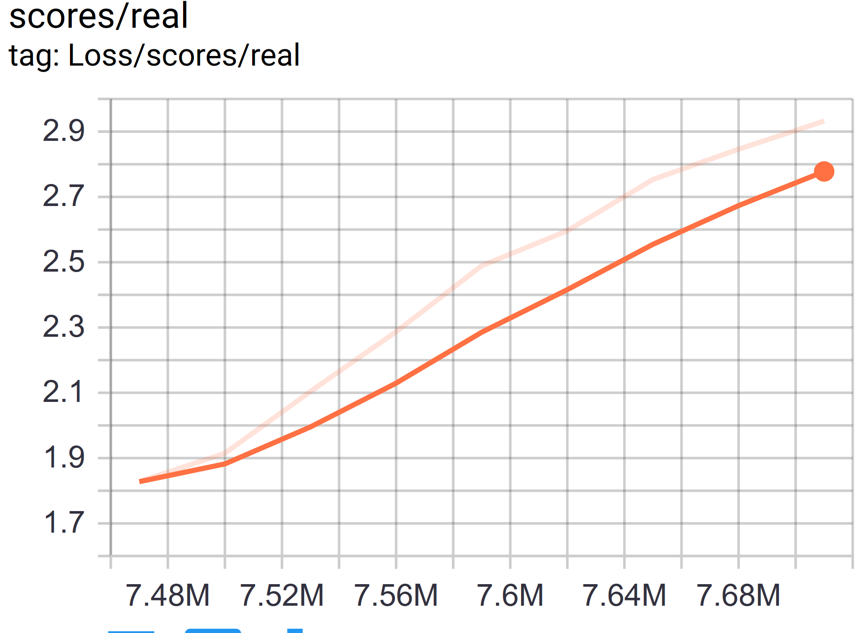
TensorBoard
r1_penalty-Generator loss is going down so producing better images
Fake_score- Discriminator Fake Loss – Getting better at classifying fake images
Real_score – Discriminator Real Loss – Getting higher and is getting worse at classifying real images
Might be due to data size or artifact blurring

Slide 21
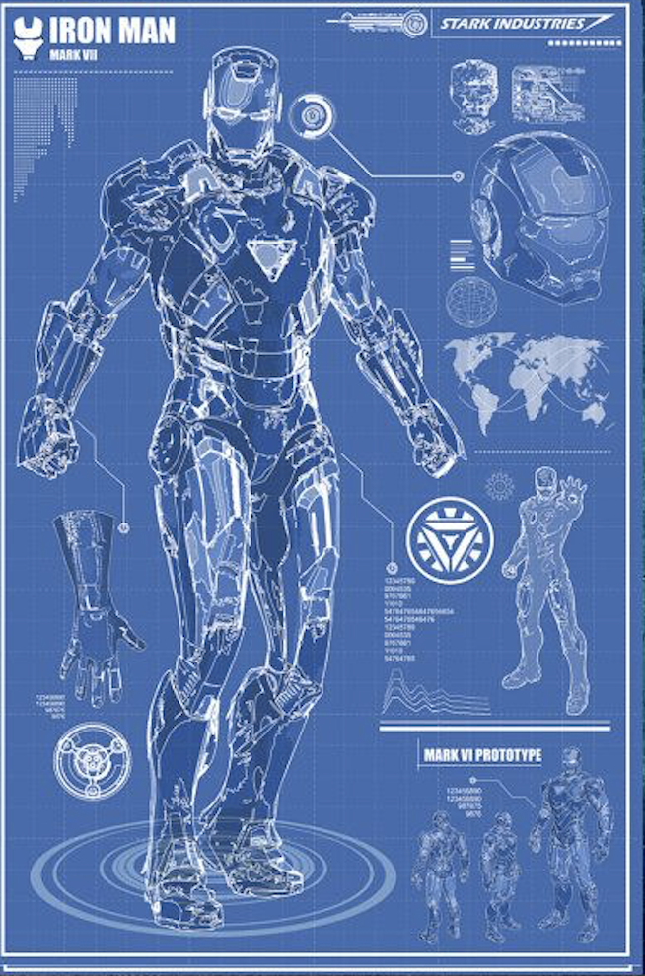
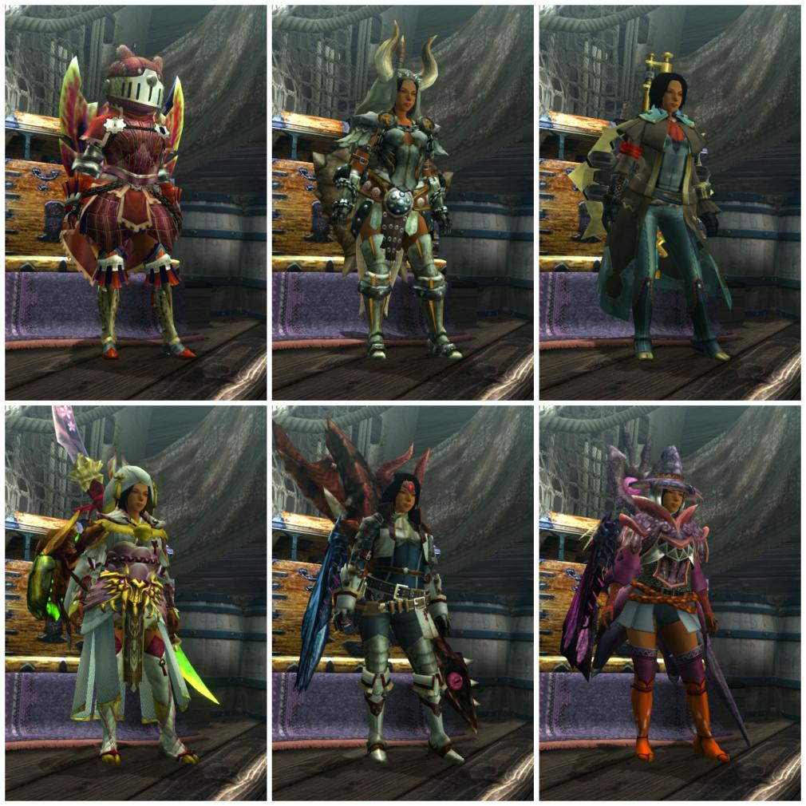
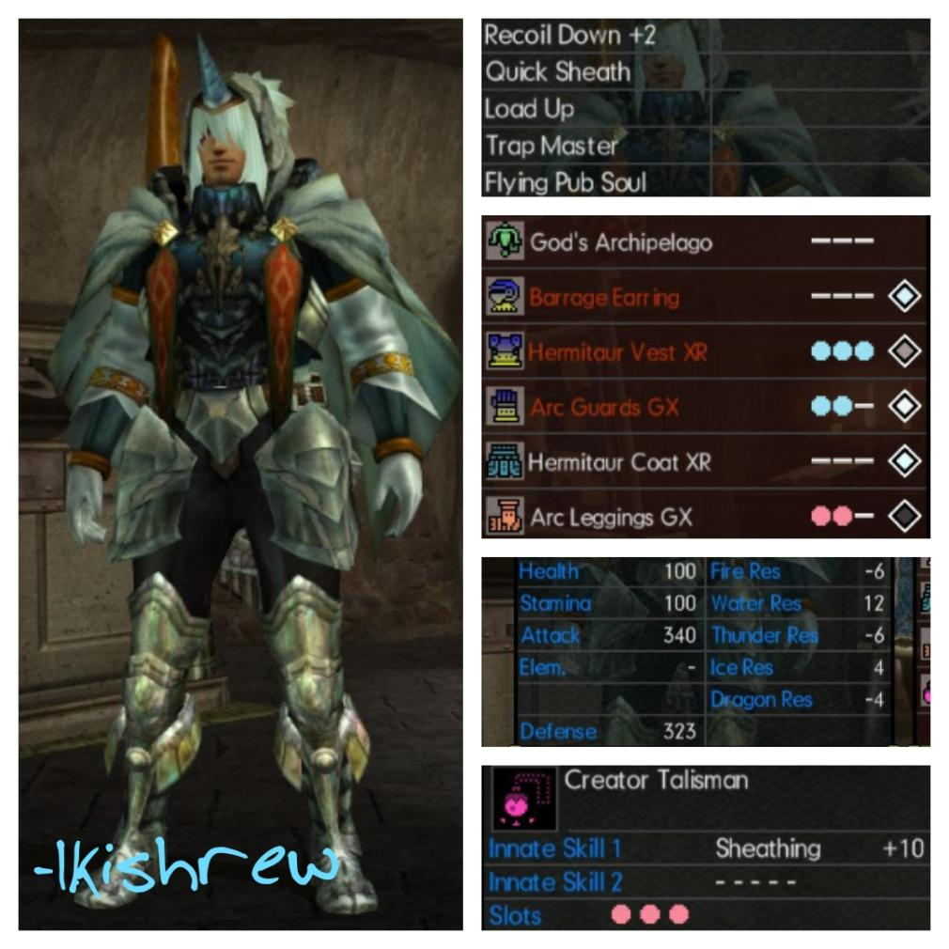
Conclusion and Improvements
Improvements to try
Mixed Armor from MH community
Ability to manipulate the vector to change features on hunter
Additions for future
GPT2 for armor combinations and hunter name
Add in more variation such as weapons and the newer MHW
Future Work to explore
Generation ideas are infinite as GAN improve
Background images and character concept illustrations

